Slide 1



COMPARATIVE ANALYSIS
ON IRONY PERCEPTION
OF KAZAKH AND CHINESE SPEAKERS
IN ONLINE COMMUNICATION
Group members: Minar, Aida, Zhansulu, Akerke

Slide 2
Group members
Akerke
experiment on Chinese speakers; Qualtrics; Statistical data interpretation
Minar
experiment on Chinese speakers; Qualtrics; Statistical data analysis;
repository creation.
Zhansulu
experiment on Kazakh speakers; Qualtrics; Statistical data interpretation; Abstract
Aida
experiment on Kazakh speakers; Qualtrics; Statistical data analysis;
repository creation.

Slide 3

What started your interest in the topic, why is it relevant or important
Chinese cultural distinction in irony
Verbal Irony is related to experimental semantics

Slide 4

Research Gap
Many studies done on verbal irony perception controlling for other factors;
A lack of research on irony in digital communication and for the effect of emojis;
Cross-cultural analysis on irony perception

Slide 5
Research Question
"How does the interpretation of verbal irony vary across age groups in Chinese and Kazakh languages within social media communication networks?"

Slide 6
Hypothesis:
Major: Chinese speakers can perceive irony better than Kazakh speakers.
Sub 1: In general, the elder people (who are above 30 in our case) tend to perceive the direct meaning more frequently compared to the younger people.
Sub 2: It is also argued that Chinese speakers can perceive the irony even without the existence of emoji.

Slide 7
Predictions:
Chinese speakers can understand irony better than Kazakh speakers in terms of verbal irony in WeChat and Telegram as their language is more ironic than the Kazakh language due to Chinese culture influence. (Chinese speakers tend to speak more implicitly due to their cultural factors.)
The people of the younger age group can understand irony better than the people of older age group because older people are less exposed to the internet communicational environment.
The existence of emoji is considered as a non-verbal clue that can help with the understanding of irony.

Slide 8
Methods
32 Kazakh speakers and 30 Chinese speakers
Survey creation and preliminary data by Qualtrics
Social media and communication applications
R Studio to analyze data

Slide 9
Experiment Design
4 conditions;
(without & with 3 types of emoji);
8 fillers; 8 stimuli
fixed variables - age, language
A link to the survey on Qualtrics
3. 16 Pictures of messages with ironic & non-ironic content
2. Consent form - agreement

Slide 10
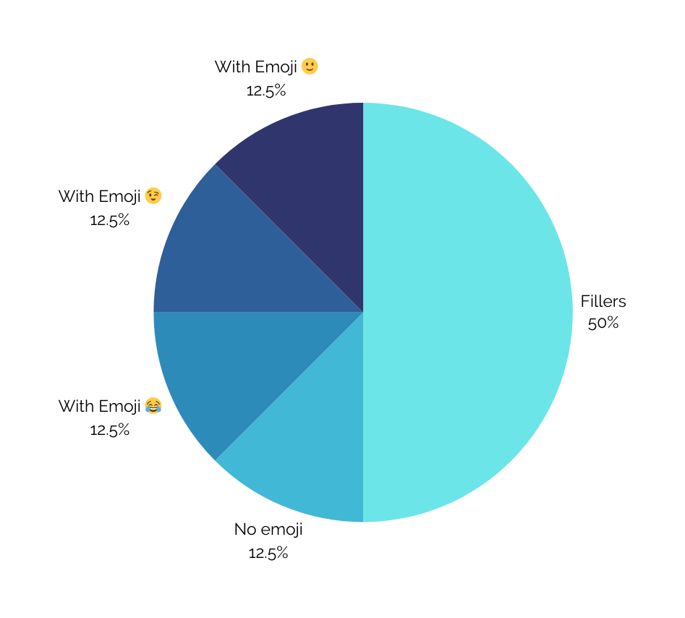
Kazakh Sample Stimuli
16 questions
8 fillers
8 stimuli
4 conditions (no emoji, with 😂, with 🙂, with 😉)
each condition had 2 questions

Slide 11
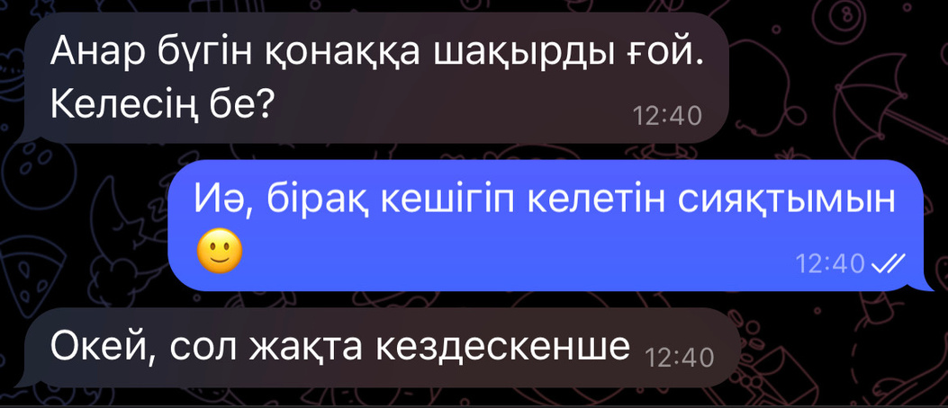
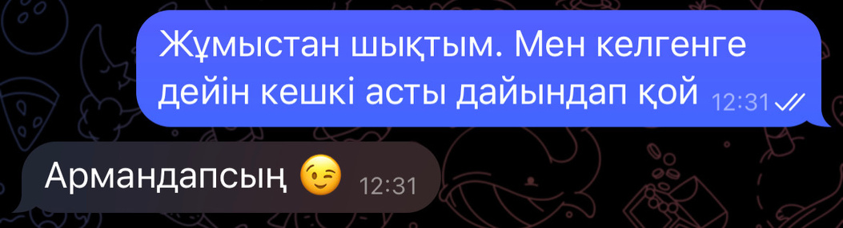
Kazakh Sample Stimuli-Filler
Question: Will B be late?
Expected Answer: [YES]
Translation:
A: Anar has invited for today. Will you come?
B: Yes, but it seems that I will be late 🙂
A: Okay, then see you there
Kazakh Sample Stimuli-with 😉
Question: Will B cook the dinner?
Expected Answer: [NO]
Translation:
A: I left the work. Cook the dinner before I come
B: In your dreams 😉

Slide 12
Chinese Sample Stimuli
We have 16 questions in total
8 are fillers and 8 are the real testing questions
We have created 4 different kinds of condition
With each kind of emoji we have 2 stimuli involved.

Slide 13


Chinese Sample Stimuli-Fillers
Question: Does A think the boss is good?
Expected Answer: [YES]
Translation:
A: Did you hear that? Tomorrow afternoon is free
B： I heard it, the boss wants us to have a good rest
A：Our boss is really nice 😉
Chinese Sample Stimuli-With 🙂
Question： Does B think A’s boyfriend arrived early?
Expected Answer: [NO]
Translation:
A: My boyfriend and I went on a date at 5 o'clock and he didn't arrive until 7 o'clock
B: Did he remember the wrong time?
A: No, he sets this time
B: Oh, he came really early then 🙂

Slide 14
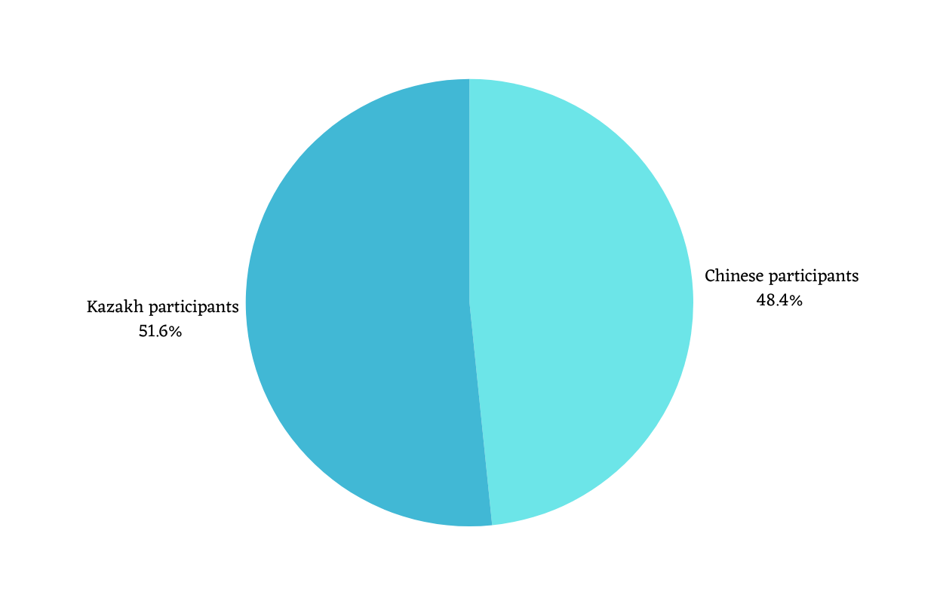


Participants
Total: 62 participants
Kazakh speakers: 32 (32 speakers < 30 y.o)
Chinese speakers: 30 (10 speakers >30 y.o; 20 speakers < 30 y. o)
Age range: 18-54

Slide 15
Our results (Raw data)
language
age
no emoji
emoji
Irony | kz | cn | age_gr1 | age_gr0 | no emoji_kz | no emoji_cn | emoji_kz | emoji_cn
Answer YES | 42,34% (105) | 27,1% (64) | 35,8%(145) | 30,4% (24) | 35,5% (22) | 27,1% (16) | 44,6% (83) | 27,1% (48)
answer NO | 57,66%(143) | 72,9% (172) | 64,2% (260) | 69,6% (55) | 64,5% (40) | 72,9% (43) | 55,4%(103) | 72,9% (129)

Slide 16
Statistical Analysis
In this project, we have decided to use R Studio to do the statistical analysis.
In addition, we have used the chi square test and logistic regression to check the statistical significance between difference variables.
As we expected the influential factors would be language difference; age difference and emoji vs. without emoji difference, we have created several different models to test the hypothesis.

Slide 17

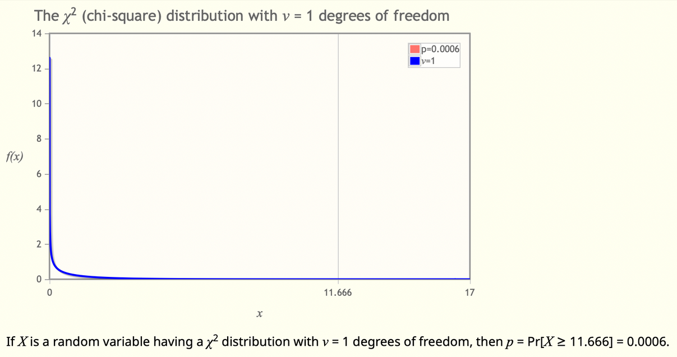
Statistical Analysis-Language Difference
Model 1: Testing whether language play a role in irony perception
Pearson's Chi-squared test with Yates' continuity correction
data: irony_language
X-squared = 11.666, df = 1, p-value = 0.0006365

Slide 18

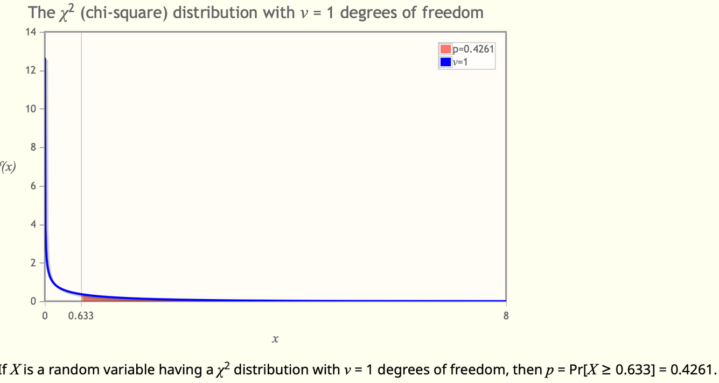
Statistical Analysis-Age Difference
Model 2: Testing whether age play a role in irony perception
Pearson's Chi-squared test with Yates' continuity correction
data: irony_age
X-squared = 0.63341, df = 1, p-value = 0.4261
We do not have a balanced number of speakers from different age; That’s probably the reason why we did not find the statistical significance.

Slide 19
Statistical Analysis-Emoji Difference
Model 3: Testing whether the existence of emoji play a role in irony perception in both language
Pearson's Chi-squared test with Yates' continuity correction
data: iroany_noemoji_emoji_kz
X-squared = 1.2388, df = 1, p-value = 0.2657
Pearson's Chi-squared test
data: irony_noemoji_emoji_cn
X-squared = 0, df = 1, p-value = 1

Slide 20

Statistical Analysis-Logistic Regression
Data: final_irony
AIC BIC logLik deviance df.resid
615.9 628.4 -304.9 609.9 481
Scaled residuals:
Min 1Q Median 3Q Max
-1.1531 -0.7033 -0.5370 1.1153 1.8622
Random effects:
Groups Name Variance Std.Dev.
response (Intercept) 0.2517 0.5017
Number of obs: 484, groups: response, 61
Fixed effects:
Estimate Std. Error z value Pr(>|z|)
(Intercept) -1.0446 0.1791 -5.833 5.45e-09 ***
kz 0.7169 0.2390 2.999 0.00271 **
---
Signif. codes: 0 ‘***’ 0.001 ‘**’ 0.01 ‘*’ 0.05 ‘.’ 0.1 ‘ ’ 1
In order to double check the true relation between the different language effect, we have also applied the logistic regression.
Since there are 2 stars in the result table, which means there is a statistical significance between the language variables: Chinese and Kazakh

Slide 21
Statistical Analysis-Other Models
Model 4: Finding statistical significance between CN and KZ no emoji difference
Pearson's Chi-squared test with Yates' continuity correction
data: irony_noemoji
X-squared = 0.6321, df = 1, p-value = 0.4266
Model 5: Finding statistical significance between CN and KZ emoji difference
Pearson's Chi-squared test with Yates' continuity correction
data: irony_emoji_kzcn
X-squared = 11.302, df = 1, p-value = 0.0007742

Slide 22
Discussion
In general, it can be argued that our major hypothesis is conformed, that is, Chinese speakers indeed tend to perceive everything more ironically.
However, our sub-hypothesis which are about the age difference and the existence of emoji did not work so well.
The absence of statistical significance in the results of the analysis does not definitively indicate that age factors play no role or that the presence of emojis has no effect on the perception of irony. Instead, further investigation is warranted to explore the nuanced relationships and potential interactions between these variables.

Slide 23
Limitations and Future Research
Limitations:
having more participants who are under 30
not having enough time to collect information from Chinese speakers
Chinese speakers had limitation in their country and could not complete the survey on time
Future Research:
diverse and larger number of participants
longitudinal studies which will track the changes in irony perception

Slide 24

Irony Group
﻿THANK YOU

